Slide 1
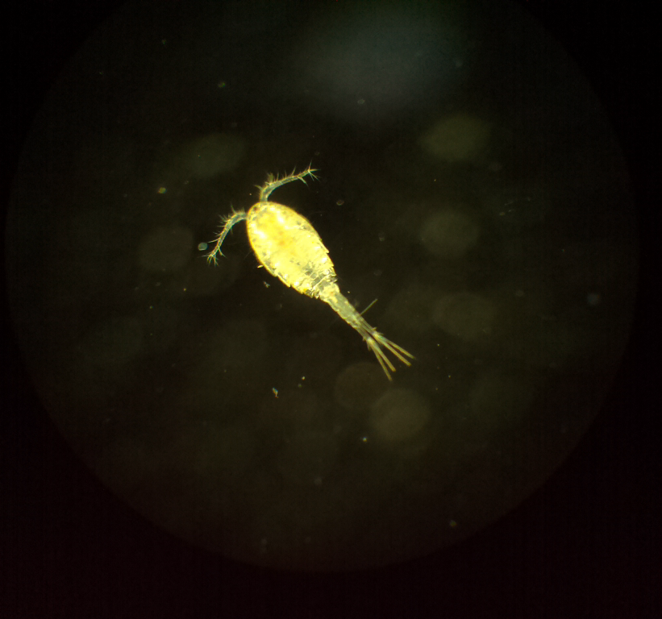
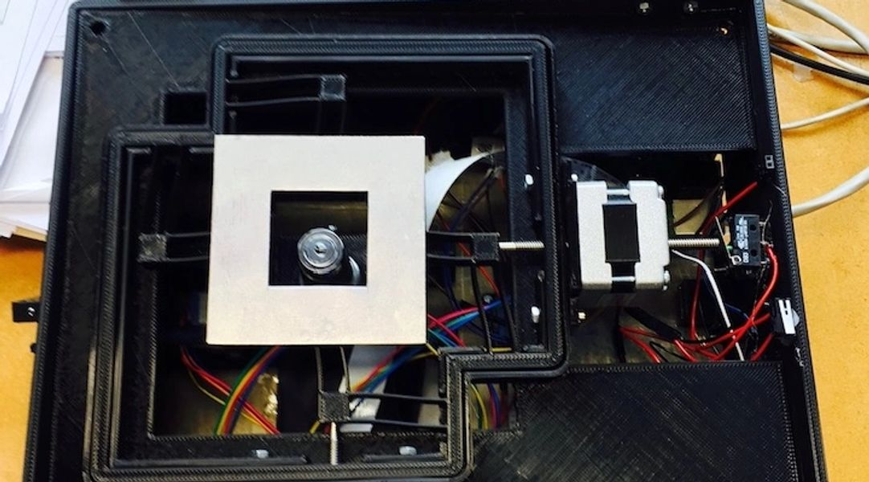
MicroscoPi Micron-Davis lab 07/08/2019
Designing & Implementing an autofocus algorithm
William Manley

Slide 2
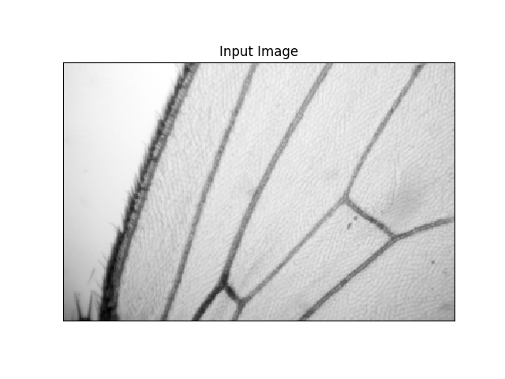
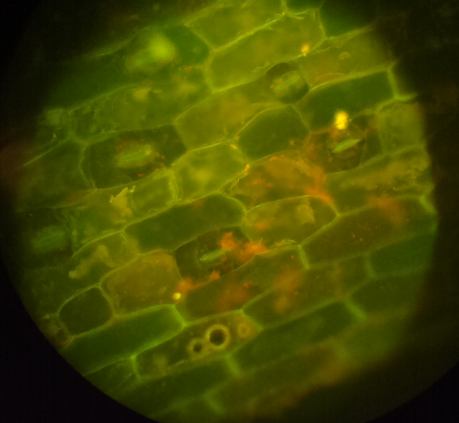
MicroscoPi
Aims to implement a low cost, robust, fully computer automated microscopy platform.
A platform developed for teaching and outreach purposes.
Specifically, facilitating teaching microscopy and programming.
Drosophila wing-bright field
Cyclops-dark field
MicroscoPi sample images
Onion epidermis-fluorescence

Slide 3
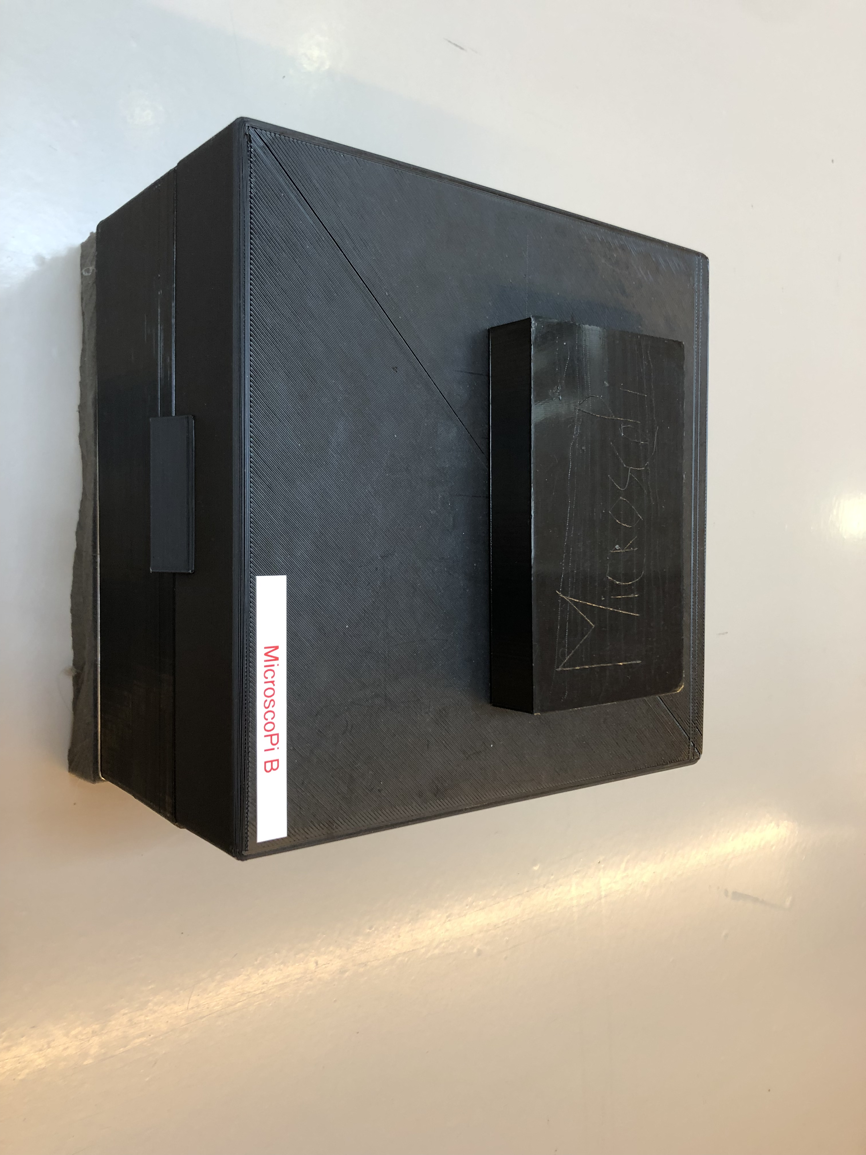
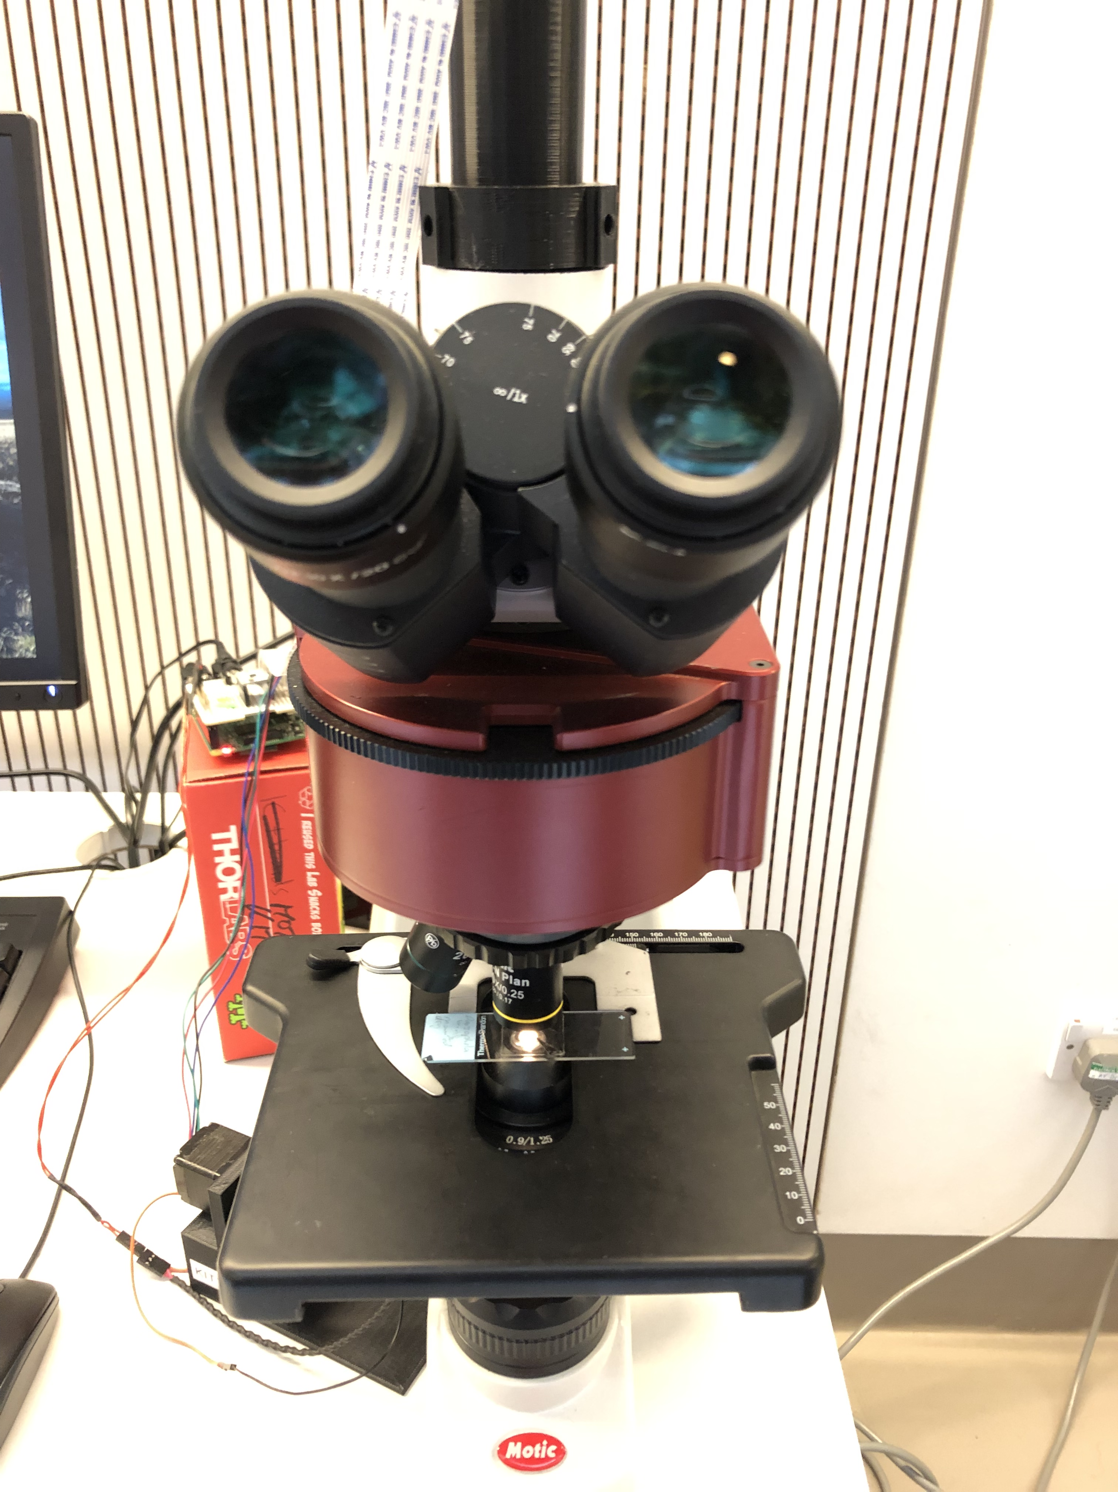
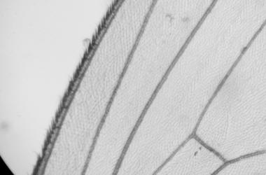
MicroscoPi
Autofocus
“In/out of focus” relates to the perceived level of sharpness/blur.
A ‘sharp’ image displays high contrast in the image details.
As we move out of focus edges spread out and perceived image detail is lost as blurring is introduced.
MicroscoPi is not like a standard microscope.
MicroscoPi unit
Conventional microscope
Drosophila wing

Slide 4
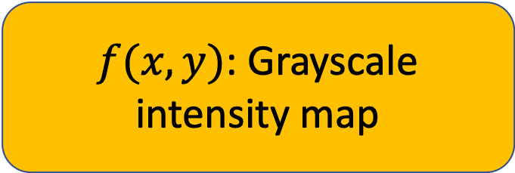
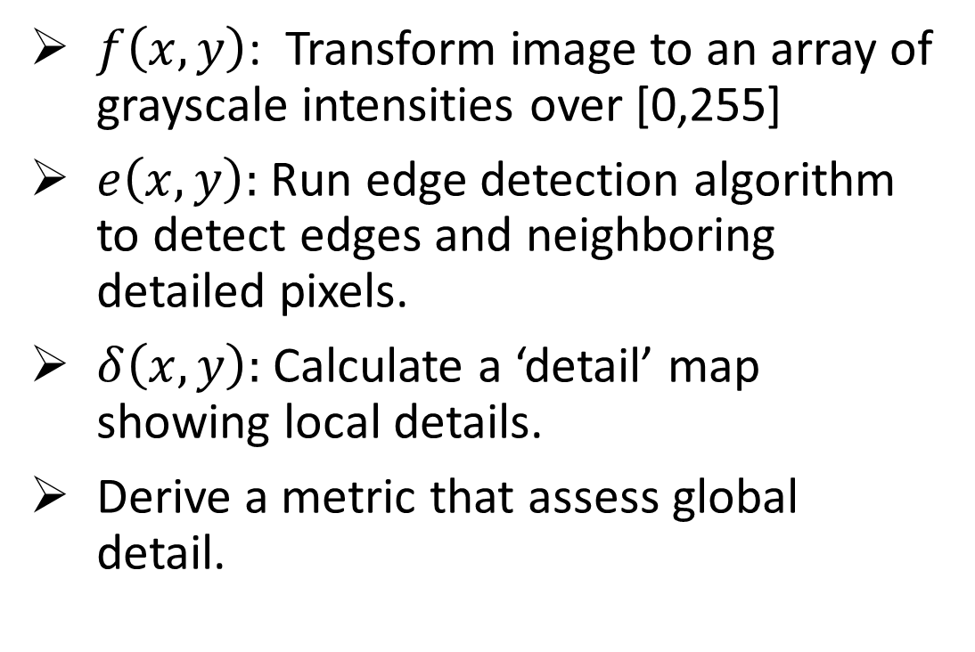
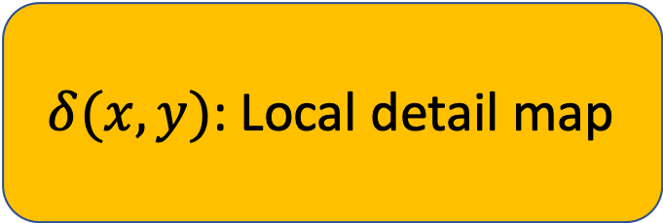
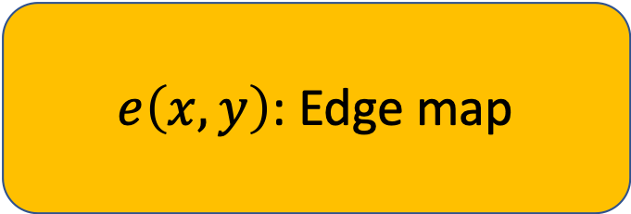
Detail Metric
$f(x,y)$: Grayscale intensity map
Metric Outline
$f\left(x,y\right)$: Transform image to an array of grayscale intensities over [0,255]
$e\left(x,y\right):$ Run edge detection algorithm to detect edges and neighboring detailed pixels.
$δ\left(x,y\right):$ Calculate a ‘detail’ map showing local details.
Derive a metric that assess global detail.
$e\left(x,y\right)$: Edge map
$δ(x,y)$: Local detail map
Idea: Assess global detail of an image in terms of local details defined by edge contrast.

Slide 5
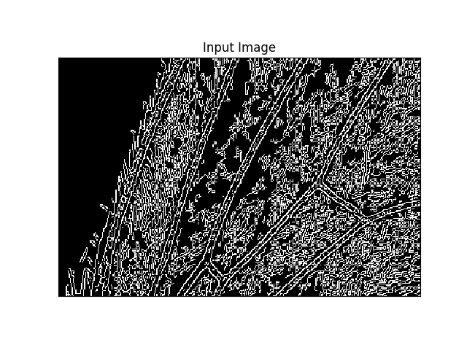
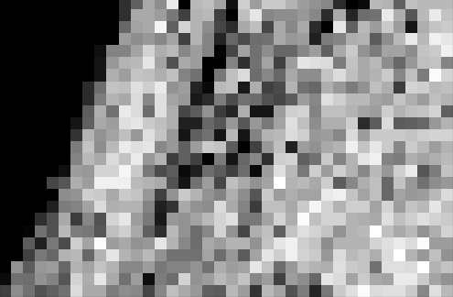
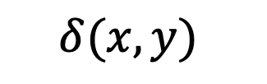
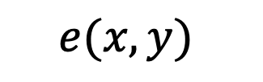
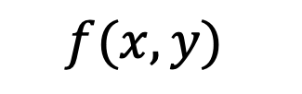
$$e(x,y)$$
$$f(x,y)$$
$$δ(x,y)$$
f
Frequent, pronounced changes in an image are associated with high levels of detail. The level of detail will vary over an image - measure locally to combat this.
f
Levels of Detail will also vary based on the sample - however changes in levels of detail in the same sample can still be detected.

Slide 6

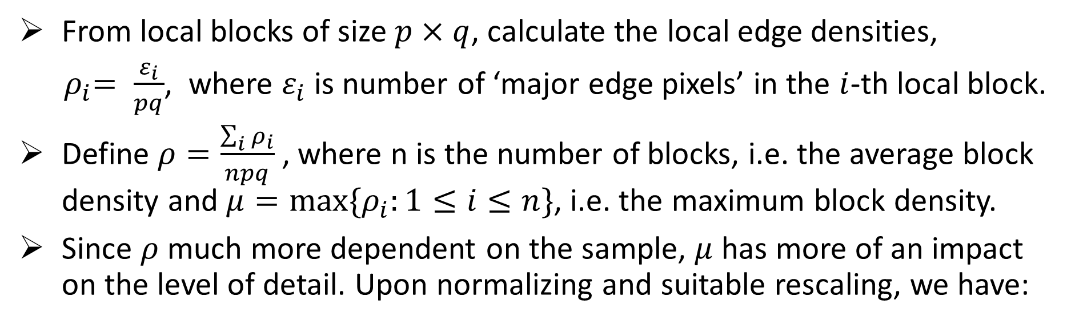
Detail Metric Derivation
From local blocks of size $p×q$, calculate the local edge densities,
${ ρ}_{i}= \frac{ε_{i}}{pq}$, where $ε_{i}$ is number of ‘major edge pixels’ in the $i$-th local block.
Define $ρ=\frac{\sum_{i}{ρ_{i}}}{npq}$ , where n is the number of blocks, i.e. the average block density and $μ=max⁡\{ρ_{i}:1≤i≤n\}$, i.e. the maximum block density.
Since $ρ$ much more dependent on the sample, $μ$ has more of an impact on the level of detail. Upon normalizing and suitable rescaling, we have:
$$δ= {\left(ρ∗\exp\left(\frac{μ−1}{μ+0.00001}\right)\right)}^{\frac{1}{10}}$$

Slide 7
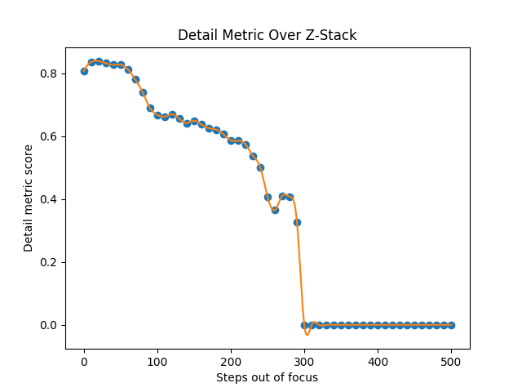
Detail Metric
Performance
Good general classification of detail.
Good for detecting when out of focus, within a relatively small region (+-300 steps).
Not so good at homing in on absolute focus (+-100 steps).
An almost identical plot is seen in dark field.

Slide 8
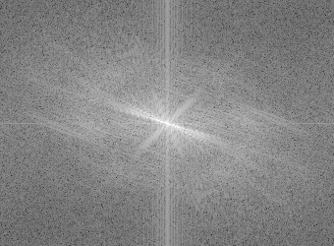
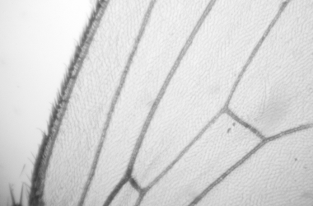
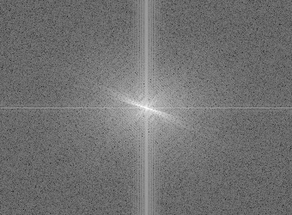
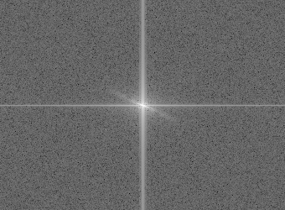
Blur Metric
Observe: Fourier spectrum change as we move out of focus
Fourier Space
We can exploit the information contained in the Fourier Transform of an image to assess blur.
As we move out of focus, higher spatial frequencies dilute and lower spatial frequencies become more concentrated.

Slide 9
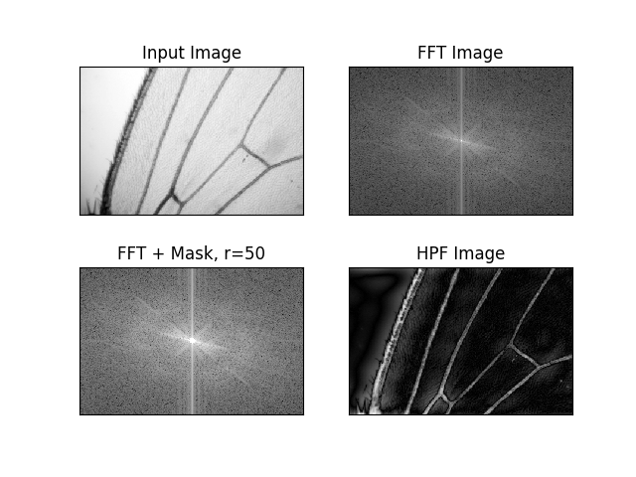
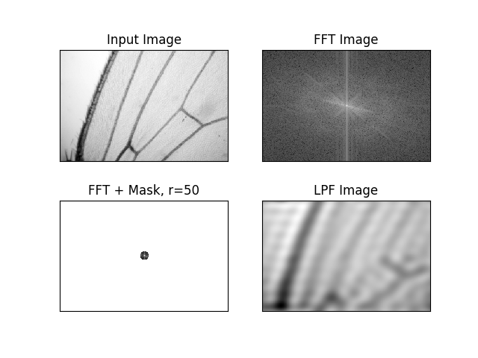
Blur Metric
High Pass Filter
Fourier Space
High spatial frequencies are associated with sharp edges and high levels of detail.
Low spatial frequencies are associated with blur and lack of detail.
Low Pass Filter

Slide 10
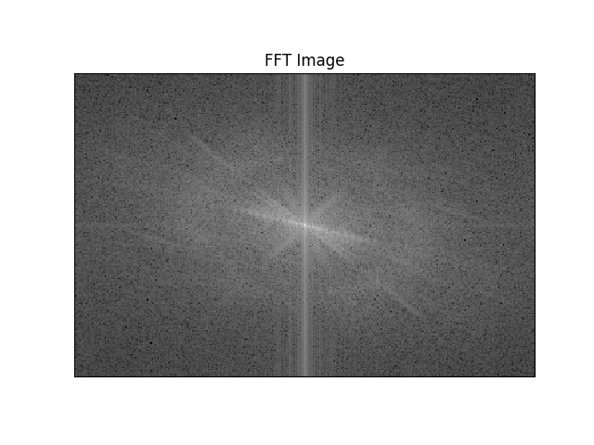
Blur Metric
Ring Energies
Given a Fourier spectrum of our image, we can calculate the relative amounts of different levels of spatial frequency.
If we sum up the magnitudes of all pixels in successive concentric rings of equal areas, we can quantify the total ‘energy’ associated with varying levels of spatial frequencies.
Idea: Quantify the levels of high & low spatial frequencies from Fourier spectrum.

Slide 11
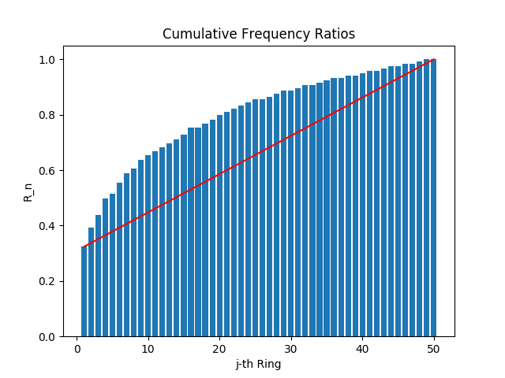
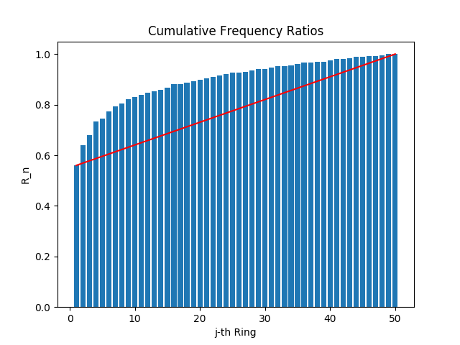
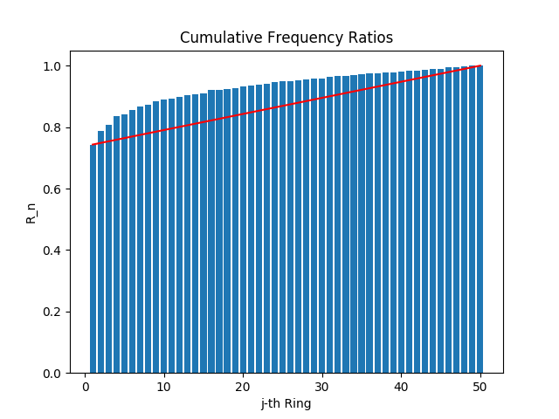
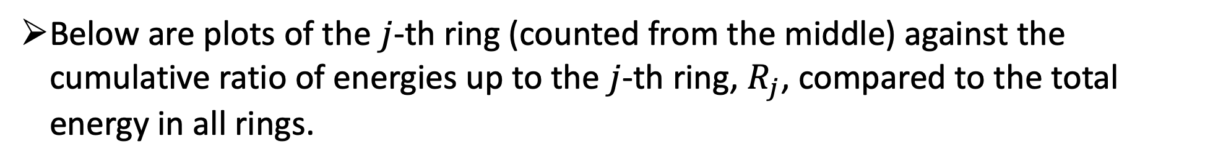
Blur Metric
Ring Energies
Below are plots of the $j$-th ring (counted from the middle) against the cumulative ratio of energies up to the $j$-th ring, $R_{j}$, compared to the total energy in all rings.
As we move out of focus, energy shifts towards low spatial frequency energy.
Absolute Focus
+-150 steps out of focus
+-500 steps out of focus

Slide 12

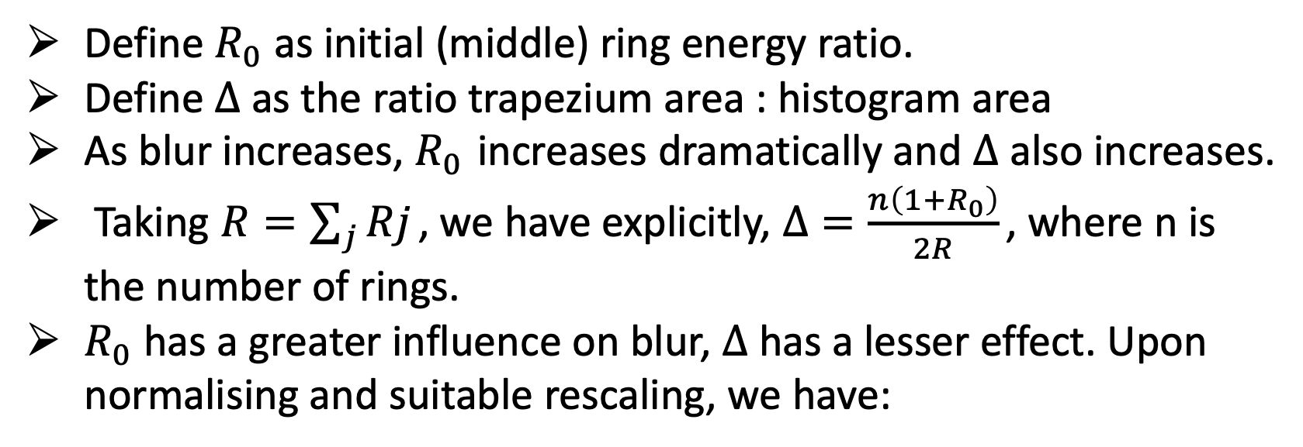
Blur Metric
Derivation
Define $R_{0}$ as initial (middle) ring energy ratio.
Define $Δ$ as the ratio trapezium area : histogram area
As blur increases, $R_{0}$ increases dramatically and $Δ$ also increases.
Taking $R=\sum_{j}{Rj}$ , we have explicitly, $Δ=\frac{n\left(1+R_{0}\right)}{2R}$ , where n is the number of rings.
$R_{0}$ has a greater influence on blur, $Δ$ has a lesser effect. Upon normalising and suitable rescaling, we have:
$$β=Δ∗exp⁡\left(\frac{R_{0}−1}{R_{0}+0.0001}\right)$$

Slide 13
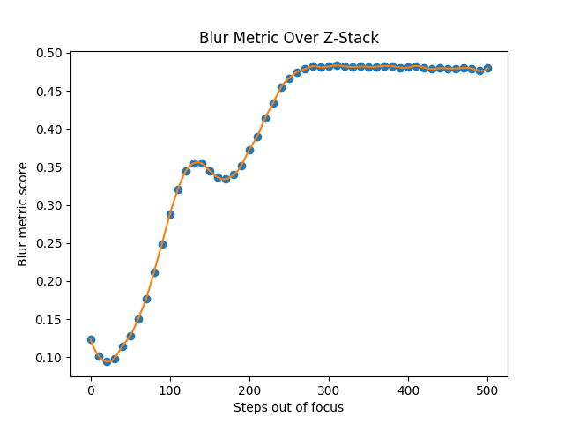
Blur Metric
Performance
Again, blur appears to have a good general fit to focus.
Blur metric much better at discriminating in a close range of focus than detail metric.
However, not good at discriminating when further away from optimal focus.
An almost identical plot is seen in dark field.

Slide 14
Autofocus
Algorithm Outline
‘Dead Reckoning’: from any start position in space return to reference point and begin.
Get to a local maximum in terms of metric assesment
Check locally/apply threshold so that don’t focus on a false positive
Select Lens and move within sensible range
Run focus assessment metrics along increment of steps, detail to get general neighborhood, blur to hone in.
Return or if false positive, ‘bump’ and continue

Slide 15


Acknowledgments
Thank you to UNIQ+ & Oxford University for giving me the opportunity to undertake this research project.
Thank you to:
Ilan Davis, Ian Dobbie, Richard Parton, Matthew Wincott & Martin Hailstone for the help I have received on my project.

